Slide 1
Effective Work Place
Presented By - Anil Kumar Sakala

Slide 2
Agenda
How to learn programming language
Hardware , software and programming
Process of programming
Java programming environment
Exception handling
How kaizen can be applied in your professional life
Conclusion

Slide 3
Organizations have problems
How to increase customer satisfaction
How to increase productivity
How to increase quality of work
How to bring down attrition

Slide 4
Solution for above problems
We require good employees to solve all above problems
Who is good employee ?
Person with technical skills?
Person with leader ship skills?
Person with good behavior?
Person with good attitude?
Person who takes more salary?
Person who takes less salary?
Good employee = Engaged employee

Slide 5
Who are Engaged Employees
“They act as though they have ownership in the business “ .This statement perfectly reflects the attitude of highly engaged employees.
Like the small business owner, such workers do whatever needs to be done, regardless of their job title
They remain motivated despite adverse circumstances , such as limited resources, equipment failures, time pressures, and so on
Engaged employees work hard for the sake of the organization and because it gives them a feeling of fulfillment
They treat the organization’s money like it was their own
In sum, highly engaged employees do whatever they can to make the organization succeed

Slide 6
Profile of an engaged employees
Brings new ideas to work
Is passionate and enthusiastic about work
Takes initiative
Actively seeks to improve self, others, and business
Consistently exceeds goals and expectations
Is curious and interested; asks questions
Encourages and supports team members
Is optimistic and positive; smiles
Overcomes obstacles and stays focused on tasks; is persistent
Is committed to the organization
They worry about the little things

Slide 7
Where do we get engaged employees
Every person who joins an organization wants to engage himself with organization for a bright and fulfilling professional career
Managers and their actions make these employees get disengaged and finally leave company
We have to hire people with good skills and make them engaged employees.
In this presentation I will talk about how managers disengage and demotivate employees with their managerial skills

Slide 8
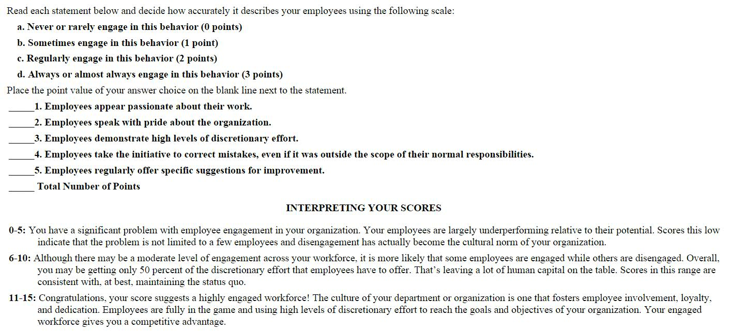
Employee Engagement Assessment Quiz

Slide 9
Advantages of engaged employees
Increased productivity
Increased profitability
Higher quality work
Improved efficiency
Lower turn over
Reduced absenteeism
Less employee theft and fraud
Higher rates of customer satisfaction
Higher employee satisfaction
Reduced lost-time accidents
Fewer EEO complaints

Slide 10
How to disengage employees
Rewards and Recognition program (There are alternative ways to motivate employees which will be discussed later which are very powerful and effective)
Unfair salary practices
Managers play a key role in disengaging employees

Slide 11
How we can engage Employees
Can we engage employees by increasing salary by 500% every year ? No
Can we engage employees by Awards & Rewards ? No
There is only way to engage employees – Effective Managers
Effective Managers = “RESPECT model”

Slide 12
RESPECT model
Recognition: Employees feel acknowledged and appreciated for their contributions. Supervisors regularly recognize deserving team members, and people are rewarded based on their work performance.
Empowerment: Supervisors provide employees with the tools, resources, and training to succeed. Employees experience high levels of autonomy and are encouraged to take risks. Supervisors take the initiative to communicate with employees and ensure that they are equipped to succeed, not fail.
Supportive feedback: Supervisors provide employees with timely, specific feedback in a supportive, sincere, and constructive manner. Feedback is delivered for the purpose of reinforcement and improvement—never to embarrass or punish.
Partnering: Employees are treated as business partners and actively collaborate in business-making decisions. They receive financial information, understand the big picture, and are given wide latitude in decision making. Supervisors serve as advocates for their employees’ development and growth. Team members and departments actively communicate and share information with one another.
Expectations: Supervisors ensure that goals, objectives, and business priorities are clearly established and communicated. Employees know precisely the standards by which their performance is evaluated and are held accountable for meeting their performance expectations.
Consideration: Supervisors, managers, and team members demonstrate consideration, caring, and thoughtfulness toward one another. Supervisors actively seek to understand employees’ opinions and concerns and are understanding and supportive when employees experience personal problems.
Trust: Supervisors demonstrate trust and confidence in employees’ skills and abilities. Employees trust that their supervisor will do right by them. Leaders keep their promises and commitments and, in return, are trusted by employees.

Slide 13
Recognition
First step in creating an engaged employee - “Recognition”
“There are two things people want more than sex and money . . . recognition and praise.”
Remove Awards & Rewards program
Three simple steps in recognizing an Employee
Observe each and every employee on his day to day work
Observe doesn’t mean micro management
Observe means paying attention to catch good things and finding ways to improve bad things
Catch them when they are doing good things
Mangers generally catch when employees are doing bad things and they don’t catch when they are doing good things
We should recognize and appreciate every act that needs to be repeated
Praise and appreciate them for every good thing they do
Praise should be honest and powerful (More on this later)

Slide 14
How it works
Thank an employee for going out of his way to take care of a customer and he will do so again.
Acknowledge a team member for taking the initiative to train a new colleague
Appreciate a person who has zero unplanned leaves and he will work hard to continue the same
Appreciate a person who had spent hours time to get work done and he feels respected
Appreciate a person in team meeting if he has taken nice session . He is more likely to repeat it
Corrective feedback from which boss is more powerful? Obviously, it’s the feedback from the one who regularly acknowledges you

Slide 15
Praise Powerfully
Powerful I mean praise that reinforces the behavior in a way that significantly increases the likelihood of that behavior occurring again in the future
Timing. Deliver praise as quickly as possible after the desired behavior.
Specificity. The goal of praise is to reinforce a specific behavior. Using general praise such as “Good job!” contributes very little to its effectiveness. Be specific and descriptive.
Proximity. One of the key factors uncovered by science that enhances the effectiveness of praise is physical proximity. The closer you are, the more impact it has.
Enthusiasm. We all know that how you say something is as important as what you say. The same applies here. Praising with energy and enthusiasm is more powerful than being stoic about it.

Slide 16
Empowerment
Empowering is all about making people under you more successful
Empowering has two basic elements
Empower to complete their day to day activities
Empower them as part of ongoing development
Empowering can happen in three simple ways – Training , resources , opportunities , decision making authority

Slide 17
Benefits of empowerment
They feel respected and engaged as they are doing their day to day activities in smooth manner
As we are increasing salaries of employees every year we expect them to be more powerful as days go by without which we can consider it as loss of money

Slide 18
Questions
Fresher's / Experienced – Are we having effective on boarding process in place and good mentor to settle down and execute their tasks on daily basis. If we don’t have this we are creating a disengaging environment in the first week itself
Instead of hiring leads / managers from outside , did we make attempts to empower our employees and create opportunities for them to become powerful and grow . If we don’t have this we are creating a disengaging environment

Slide 19
Solution for above problems
We require good employees to solve all above problems
Who is good employee ?
Person with technical skills?
Person with leader ship skills?
Person with good behavior?
Person with good attitude?
Good employee = Engaged employee

Slide 20
Solution for above problems
We require good employees to solve all above problems
Who is good employee ?
Person with technical skills?
Person with leader ship skills?
Person with good behavior?
Person with good attitude?
Good employee = Engaged employee

Slide 21
Solution for above problems
We require good employees to solve all above problems
Who is good employee ?
Person with technical skills?
Person with leader ship skills?
Person with good behavior?
Person with good attitude?
Good employee = Engaged employee

Slide 22
Solution for above problems
We require good employees to solve all above problems
Who is good employee ?
Person with technical skills?
Person with leader ship skills?
Person with good behavior?
Person with good attitude?
Good employee = Engaged employee

Slide 23
Solution for above problems
We require good employees to solve all above problems
Who is good employee ?
Person with technical skills?
Person with leader ship skills?
Person with good behavior?
Person with good attitude?
Good employee = Engaged employee

Slide 24
Solution for above problems
We require good employees to solve all above problems
Who is good employee ?
Person with technical skills?
Person with leader ship skills?
Person with good behavior?
Person with good attitude?
Good employee = Engaged employee

Slide 25
Solution for above problems
We require good employees to solve all above problems
Who is good employee ?
Person with technical skills?
Person with leader ship skills?
Person with good behavior?
Person with good attitude?
Good employee = Engaged employee

Slide 26
Solution for above problems
We require good employees to solve all above problems
Who is good employee ?
Person with technical skills?
Person with leader ship skills?
Person with good behavior?
Person with good attitude?
Good employee = Engaged employee

